Slide 1
Technical Project Report

Slide 2
A report is a
Reconstruction of an investigation
Reconstruct: build or form (something) again

Slide 3
The Project Report
The project report is the formal record of the entire process you undertook to complete your Personal Project.

Slide 4
Anatomy of a Report
Format and Components
Prefatory Parts
The Text
Chapter 1 – Introduction
Chapter 2 – Literature Review
Chapter 3 –Requirements / Analysis
Chapter 4 – Design
Chapter 5 – Implementation and test
Chapter 6 – Evaluation
Chapter 7 – Conclusion
Supplementary Parts

Slide 5
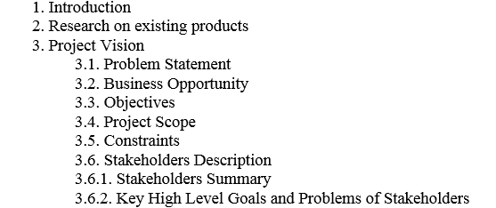
Development FYP Report Format

Slide 6
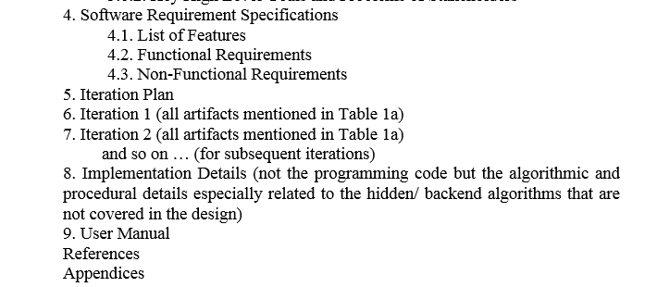
Contd.

Slide 7
Introduction Chapter/Section
Motivation
Why the area is important
Establishing a specific problem or need
End with statement of the problem
Identifying a problem or a need
Giving background information
Reviewing previous research

Slide 8
Introduction- Format and Components
Project Vision
3.1. Problem Statement
3.2. Business Opportunity
3.3. Objectives
3.4. Project Scope
3.5. Constraints
3.6. Stakeholders Description
3.6.1. Stakeholders Summary
3.6.2. Key High Level Goals and Problems of Stakeholders

Slide 9
Example (Motivation)
The project designed and developed an airline reservation system which the users can use to book a flight and obtain flight details.
To simplify the flight reservation process for customers
To provide the users with a safe and secure online payment gateway
To allow users to obtain all flight details including departure time, delays, check in time

Slide 10
Examples of Objectives
The objectives of this Online Examination System are:
To automate the testing activity.
To centralize control of all the units that are involved in the online testing system.
To provide data security from unauthorized users.

Slide 11
Examples of Objectives
The main goal of this online pharmacy is
To assist the user in easily finding medicines that are available
To suggest alternate stores if the medicine is unavailable
To provide the admin with a mechanism to determine the validity of a prescription

Slide 12
Scope of the Project
Talks about goals and deliverables of the project
explains the boundaries of the project
establishes responsibilities for each team member
sets up procedures for how completed work will be verified and approved.

Slide 13
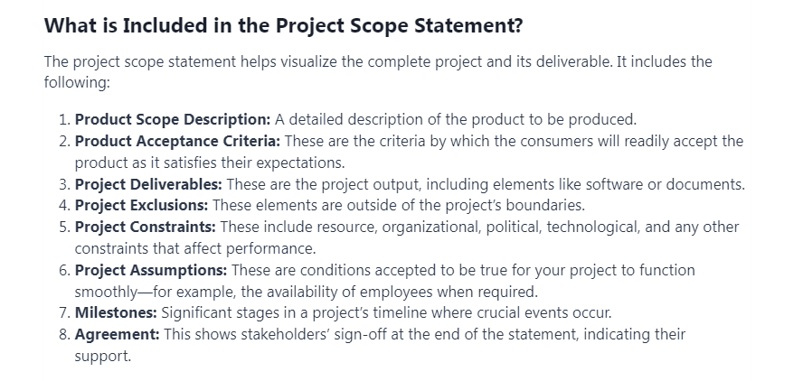

Slide 14
More on Scope
https://pmstudycircle.com/project-scope-statement/
https://www.betterup.com/blog/project-scope

Slide 15
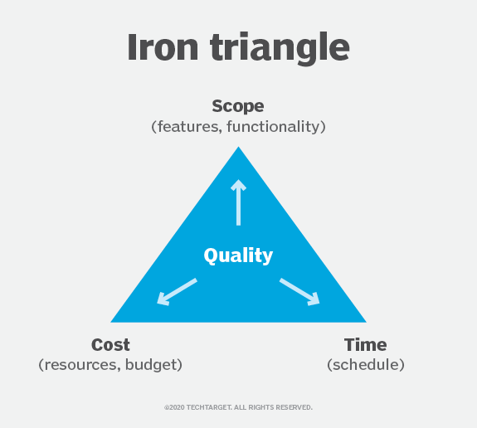
Introduction Chapter/Section
Constraints in Projects

Slide 16
Introduction Chapter/Section
A constraint in project management is any restriction that defines a project's limitations. For example, a project's scope is the limit of what the project is expected to accomplish.
The three most significant project planning and management constraints are time, cost and scope. They are sometimes known as the triple constraint or the project management triangle or the iron triangle.

Slide 17
Introduction Chapter/Section
Scope
refers to the breadth and depth of features and functionalities incorporated into the software.
defines the boundaries of the project,
Cost
represents the financial investment allocated to various aspects of software development
includes initial development, necessary resources, and ongoing maintenance.
Time
dictates the deadlines for project delivery and establishes key milestones throughout the development process
also includes the project’s schedule and the time at which each part of the project should be completed, including final delivery.

Slide 18
Introduction Chapter/Section
More reading on Constraints
https://www.techtarget.com/whatis/definition/constraint-project-constraint#:~:text=A%20constraint%20in%20project%20management,are%20time%2C%20cost%20and%20scope.
https://www.apriorit.com/dev-blog/how-to-manage-constraints-in-software-development-effectively

Slide 19
Who are stakeholders?
End User and Beneficiaries
Direct User
Secondary User
Beneficiaries-Customers and Vendors

Slide 20
Stakeholders
Direct Users
The direct users of the software
They want to know that it solves a significant problem or otherwise makes their job easier
Secondary Users
Secondary users rely on the products of the software.
Beneficiaries
all the people affected by the software’s products.

Slide 21
Literature Review Chapter
A literature review is a piece of academic writing demonstrating knowledge and understanding of the academic literature on a specific topic placed in context. A literature review also includes a critical evaluation of the material; this is why it is called a literature review rather than a literature report. It is a process of reviewing the literature, as well as a form of writing.

Slide 22
Literature Review Chapter
Introduce Research Area, technology
Define it
Discuss its significance with respect to stakeholders and business benefits
Discuss how the tech solves different problems for the stakeholders and provides different benefits

Slide 23
Literature Review Chapter
Discuss current state of the art of the technology, everything it can do, research niches, major achievements
Discuss latest research studies on the tech
Discuss the studies method wise and feature wise
Discuss limitations/weaknesses of the studies acknowledging their contribution

Slide 24
Literature Review Chapter
Now create a need for a solution
End with your research problem
Re-discuss your project objectives
Bonus: tools, languages, software packages, etc.

Slide 25
Method
Specifications-SRS
Software Design Specifications-SDS
Implementation
Tests to be Run

Slide 26
Results and Evaluation
Describe the tests you will run.
Provide reasoning behind the choice of tests
Provide a comprehensible summary of the results of all the tests conducted
Describe the extent to which you achieved your goals

Slide 27
Conclusion and Recommendations
Conclusion
Summary of all previous chapters except literature review
Appraisal of project
Critically evaluate your results
Describe strengths and weaknesses
Compare your work with others

Slide 28
Conclusion and Recommendations
Recommendations
For stakeholders: encourage them to use the proposed solution
For researchers: provide practical ideas about how to extend the project
Discuss project limitations and provide ideas about improvements

Slide 29
Recommendations Examples
A robot called RoboMaid was successfully built by our team.
The robotic toy could , however, be further improved to do other tasks by using more sophisticated software and a wider range of programs.
Using the same principle, future projects should undertake the construction of other appliances which could perform more useful tasks than just serving drinks.

Slide 30
Recommendations Examples
The machine could be further improved in numerous areas. The following changes are recommended :
1) Adding memory cards to increase limited RAM space of the controller.
2) Using a G5 microprocessor to control and stabilise the current source during start up.
3) Using discrete digital selector and display to select current level.
More work has to be done in the following areas :
1) The function of the machine could be expanded to access Linux computers.
2) Another UNIX server could be integrated for security purposes.

Slide 31
Recommendations Examples
It is recommended that :
4.1 (the correct no.) the feasibility of using perspex be considered;
4.2 the base be attached with Superglue instead of screws;
Suggestions:
1. the base of the sharpener could be extended to give it greater stability;
2. the sharpener could be made in different colours to make it more attractive.

